Slide 1
DAX PRACTICE #3
Time Intelligence &
Advanced Measures
• SUMX & VAR patterns
• YoY, MoM, YTD, QTD, MTD
• Power BI Desktop

Slide 2
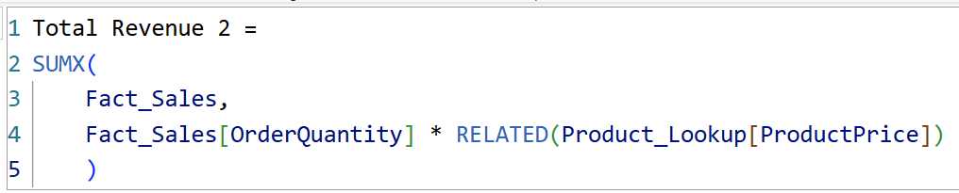
Total Revenue 2
What it does:
SUMX is an iterator - goes row by row through Fact_Sales
For each row, multiplies OrderQuantity by ProductPrice (pulled in via RELATED)
After every row is calculated, adds all the results together
Output: One total revenue number - the sum of every row's calculated revenue, based on whatever filter is applied (year, product, region, etc.)

Slide 3
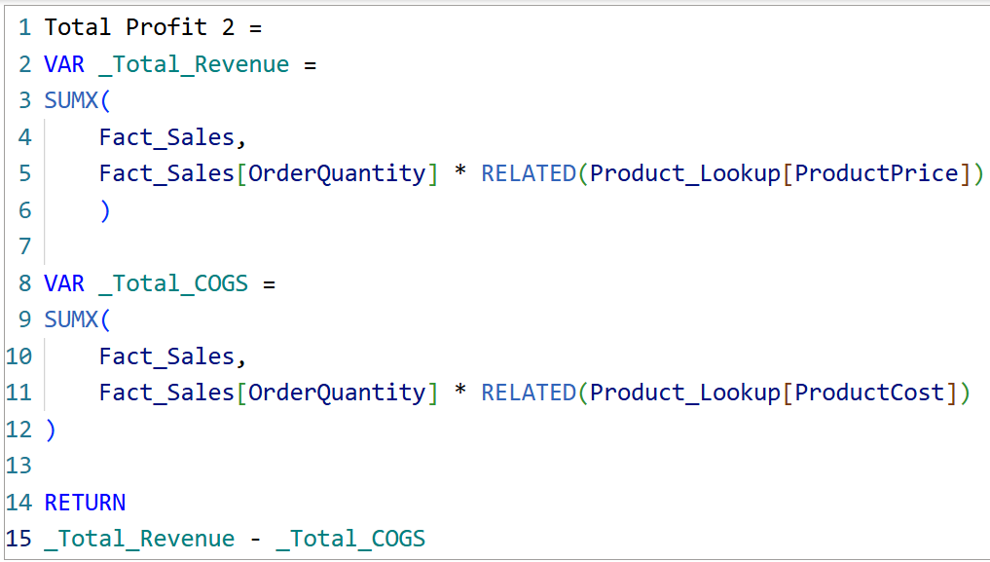
Total Profit 2
What it does:
VAR calculates revenue and cost once, then stores them as short, reusable names
Then subtracts cost from revenue to get profit
Output: One total profit number - built from clear, reusable steps instead of one long formula.

Slide 4
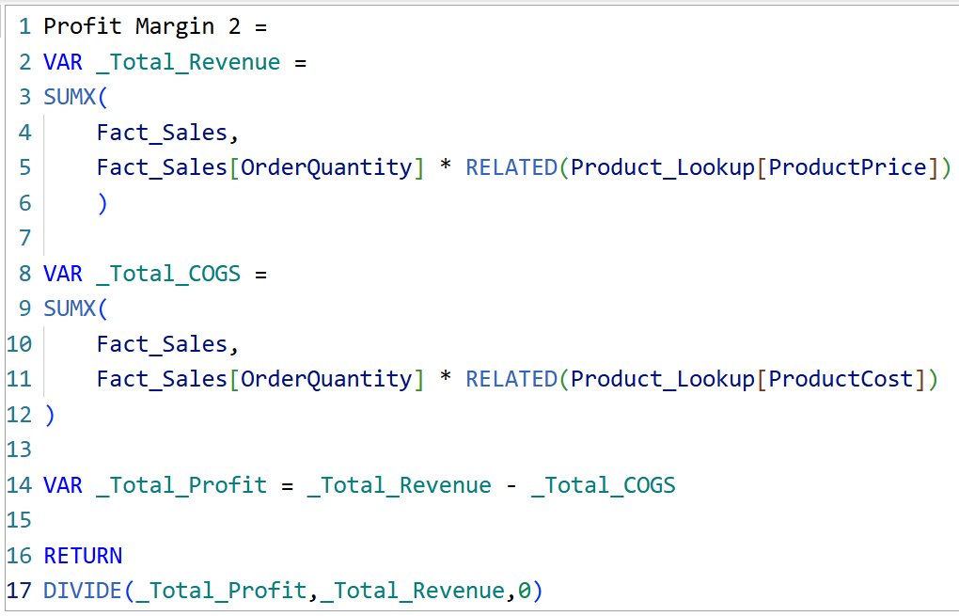
Profit Margin 2
What it does:
Uses VAR to calculate revenue, cost, and profit first
Divides profit by revenue using DIVIDE, which returns blank instead of an error if revenue is 0
Output: Profit margin shown as a percentage, safe from divide-by-zero errors.

Slide 5
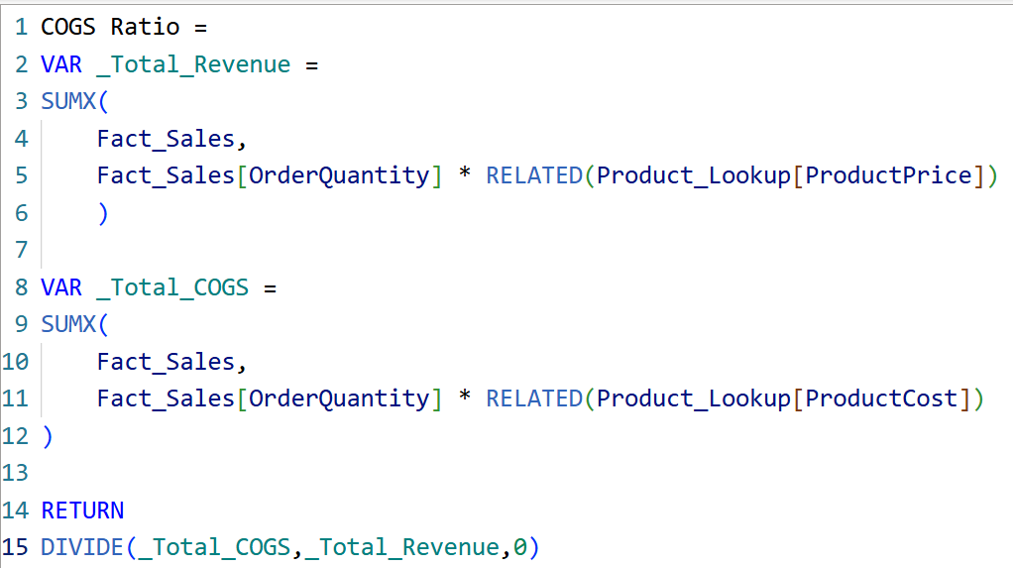
COGS Ratio
What it does:
Same VAR + DIVIDE pattern as profit margin
Divides cost by revenue instead of profit by revenue
Output: Cost of goods sold (COGS) shown as a percentage of revenue.

Slide 6
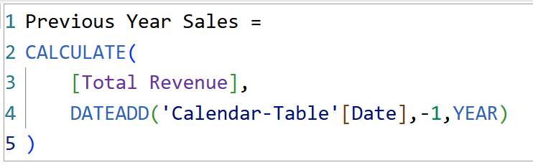
Previous Year Sales - DATEADD
What it does:
CALCULATE changes the filter, then recalculates revenue
DATEADD shifts every date back by 1 year (Number = -1, Interval = YEAR)
Output: Revenue from the same period last year.

Slide 7
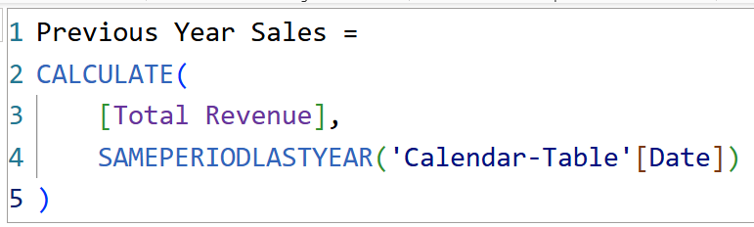
Previous Year Sales - SAMEPERIODLASTYEAR
What it does:
Returns the same dates as this year, just shifted back one year
Same result as DATEADD(-1, YEAR), just a shorter, simpler function name
Output: Same result as the DATEADD version - just a cleaner, shorter formula.

Slide 8
Year Wise Sales Diff
What it does:
Takes Current Year Sales
Subtracts Previous Year Sales: Current Year Sales - Previous Year Sales
Output: How much revenue went up or down compared to last year.

Slide 9
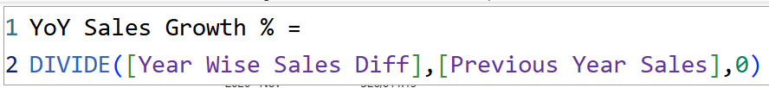
YoY Sales Growth %
What it does:
Divides the yearly difference by Previous Year Sales
DIVIDE keeps it safe from errors when last year's revenue is 0
Output: Growth compared to last year, shown as a percentage.

Slide 10
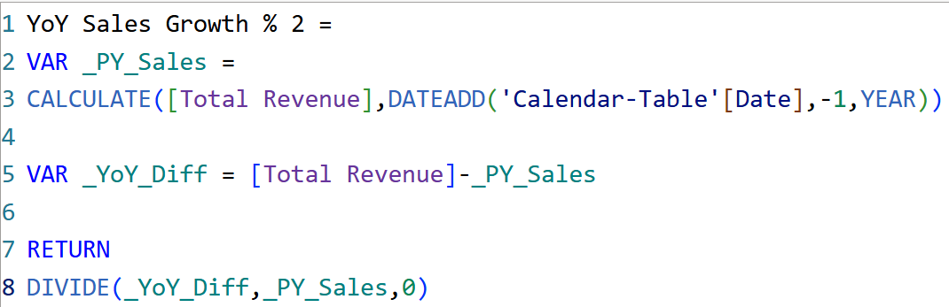
YoY Sales Growth % 2
What it does:
Same YoY growth logic, written as a single measure
VAR stores current year, previous year, and the difference, then reuses them
Output: Same growth % as before - confirms the formula is correct.

Slide 11
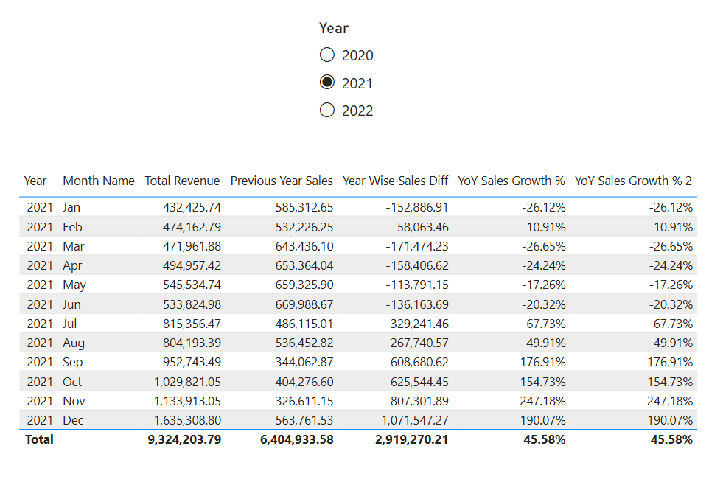
YoY Output - Sliced by Year
What it does:
Table filtered to year 2021
Shows revenue, last year's revenue, the difference, and both growth % formulas side by side
Output: Both growth % formulas match every month - proof the two versions calculate identically.

Slide 12
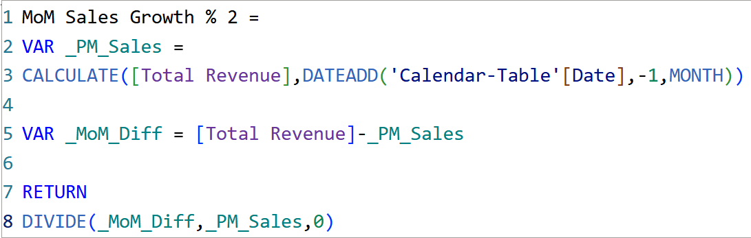
MoM Sales Growth % 2
What it does:
Same idea as YoY, but DATEADD shifts back 1 month instead of 1 year
MoM Sales Growth % = MoM Sales Different / Previous Month Sales
Output: Growth compared to last month, shown as a percentage.

Slide 13
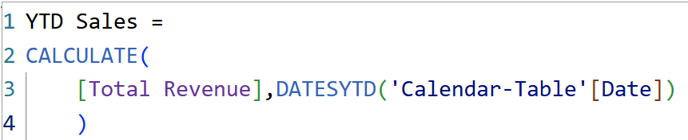
YTD Sales
What it does:
DATESYTD returns every date from Jan 1 to the current date in the filter
CALCULATE adds up revenue across those days - restarts fresh every new year
Output: Running total of sales so far this year.

Slide 14
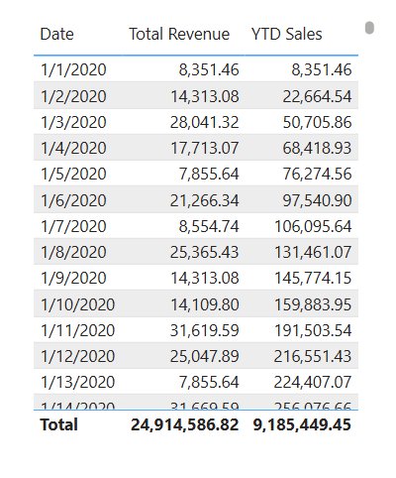
YTD Output - Daily Running Total
What it does:
Table shows revenue next to YTD sales for each day - YTD keeps accumulating as the year goes on
Output: By Jan 14, YTD sales reached 256,076.66 - the running total so far.

Slide 15
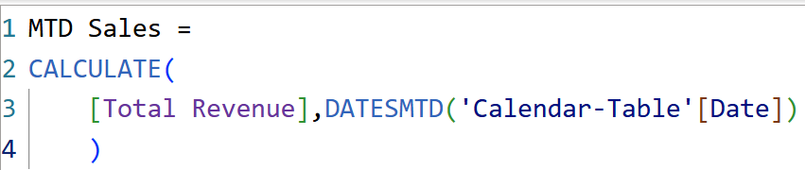
MTD Sales
What it does:
DATESMTD returns every date from the 1st of this month to today - restarts each new month
Output: Running total of sales so far this month.

Slide 16
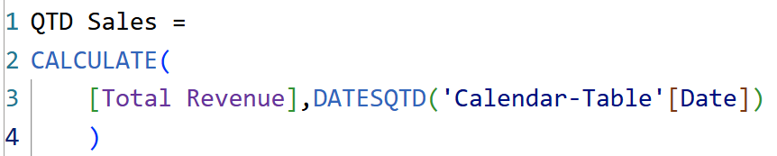
QTD Sales
What it does:
DATESQTD returns every date from the start of this quarter to today - restarts each new quarter
Output: Running total of sales so far this quarter.

Slide 17
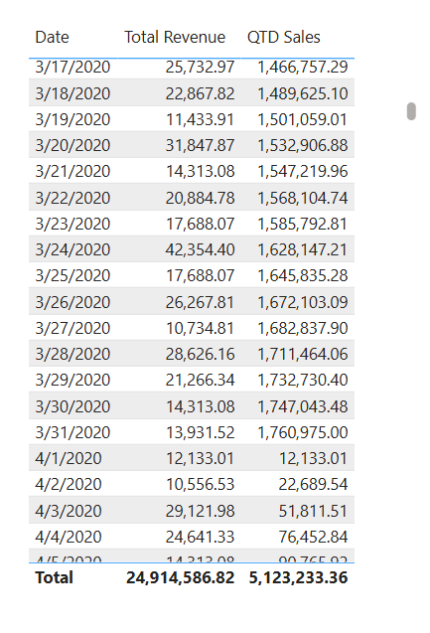
QTD Output Resets Each Quarter
What it does:
Table tracks revenue and QTD sales through March
QTD keeps accumulating through the quarter, reaching 1,760,975.00 by March 31
Output: On April 1, QTD resets to 12,133.01 - proof it starts over each new quarter.

